Slide 1



Developing a datasets-based R package
to teach environmental data science
Allison Horst (Bren School, UC Santa Barbara)
Julien Brun (NCEAS, UC Santa Barbara)
Notes:
Allison: Hi everyone, thank you for joining us today. We’re excited to tell you about our process of “Developing a datasets-based R package to teach environmental data science.”
I’m Allison Horst, I’m an Assistant Teaching Professor at the Bren School of Environmental Science and Management at UC Santa Barbara.
Julien: Hi everyone, I’m Julien Brun, I am a Senior Data Scientist at NCEAS where I help scientists to develop reproducible analytical workflows.

Slide 2
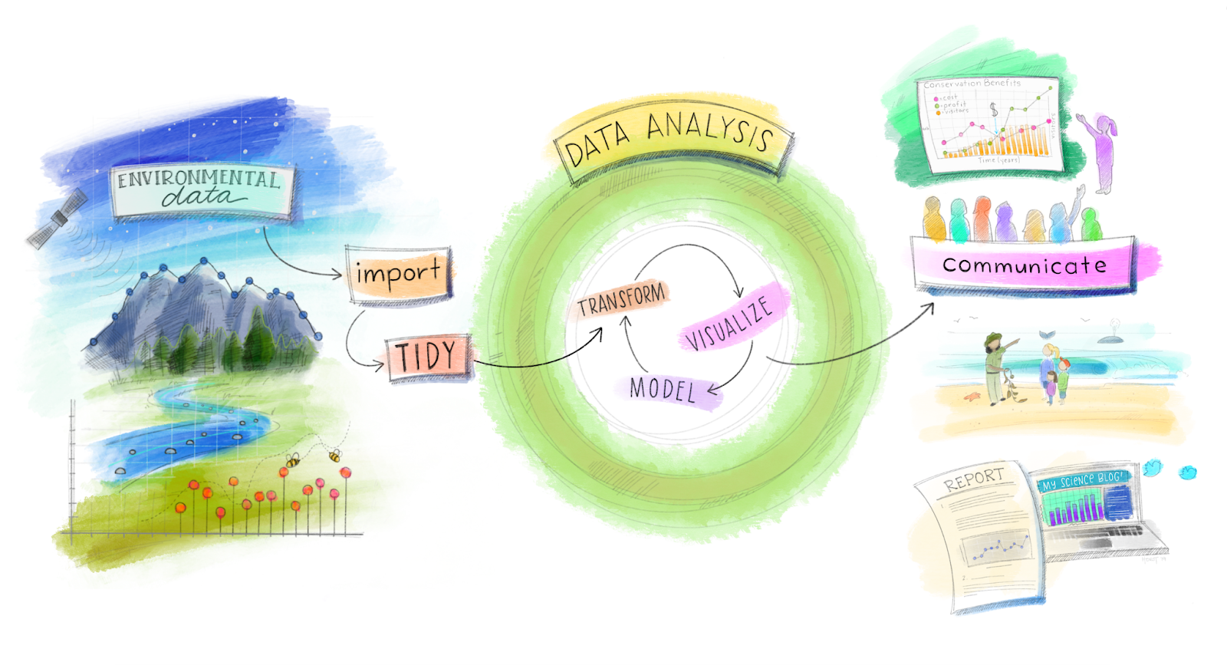
Adaptation of Grolemund & Wickham’s R4DS for environmental data science, envisioned by Dr. Julia Lowndes for her 2019 useR! keynote (illustrated by Allison Horst).
Notes:
Allison: Julien and I both teach environmental data science - which means that we help students and researchers gain skills to investigate environmental challenges and questions using environmental data, and we help them do that more reproducibly, efficiently, and collaboratively through our teaching and training.

Slide 3
Adaptation of Grolemund & Wickham’s R4DS for environmental data science, envisioned by Dr. Julia Lowndes for her 2019 useR! keynote (illustrated by Allison Horst).
Notes:
Allison: Most of our content focuses on how to work with and analyze existing environmental data, so you’d think that most of our prep time would be creating materials on things like data wrangling, statistical approaches and reporting. And that’s usually true...but it turns out there is a really time consuming thing that often gets overlooked.

Slide 4
Adaptation of Grolemund & Wickham’s R4DS for environmental data science, envisioned by Dr. Julia Lowndes for her 2019 useR! keynote (illustrated by Allison Horst).
Notes:
Allison: ...and that’s the process of finding modern, well-documented environmental datasets that are useful and interesting for our teaching.

Slide 5
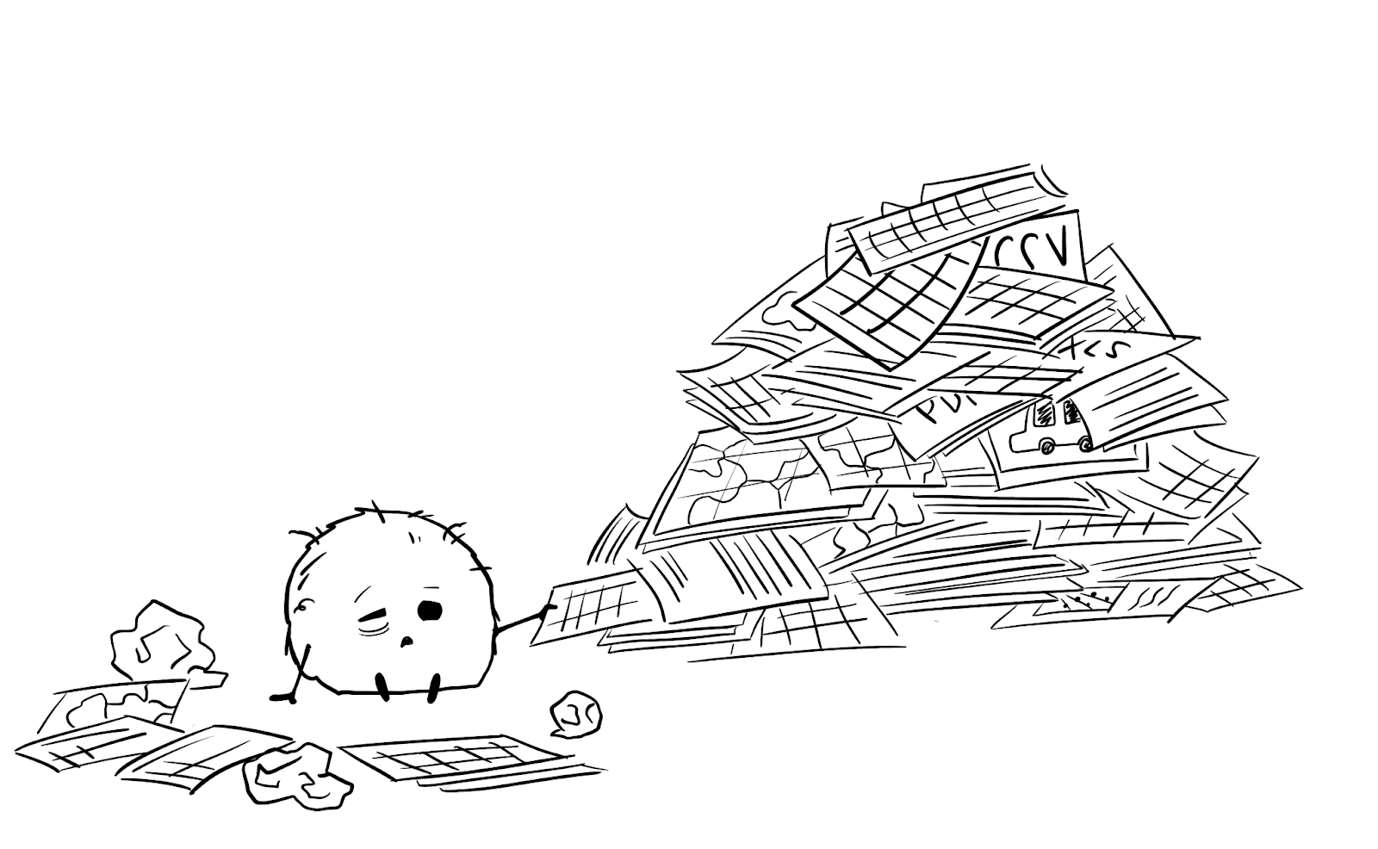
Real
Environmental
Openly available
Easily accessible
Well documented
Appropriate for teaching topics
Quickly understandable by students
Manageable size
Modern
Charismatic
Notes:
Allison: The issue is not that there aren’t openly available environmental datasets - there are a ton of repos full of all environmental data of all flavors. The issue is that it can take a teacher a really long time to locate, download, explore, curate, test, and make a lesson with them from scratch. When you start considering the different checkboxes that would make an ideal dataset (like real, environmental, open, accessible, thorough metadata, etcetera), you might imagine - correctly - that this can take a lot of time and energy.

Slide 6
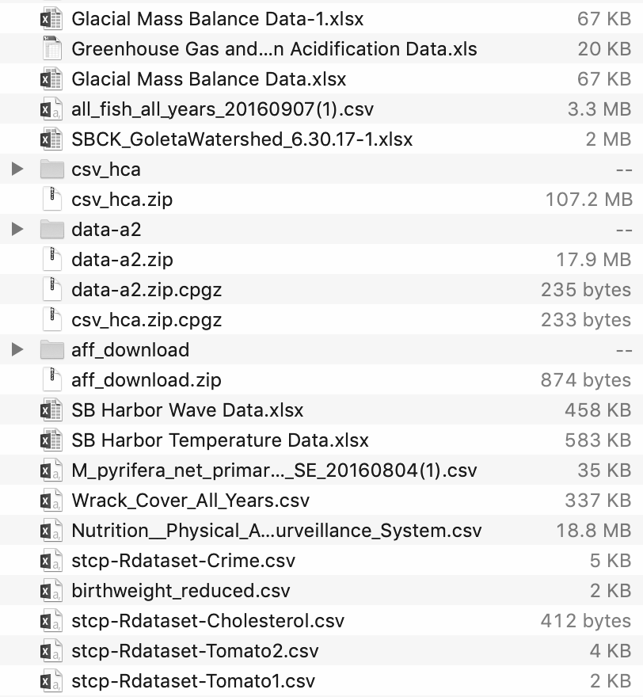
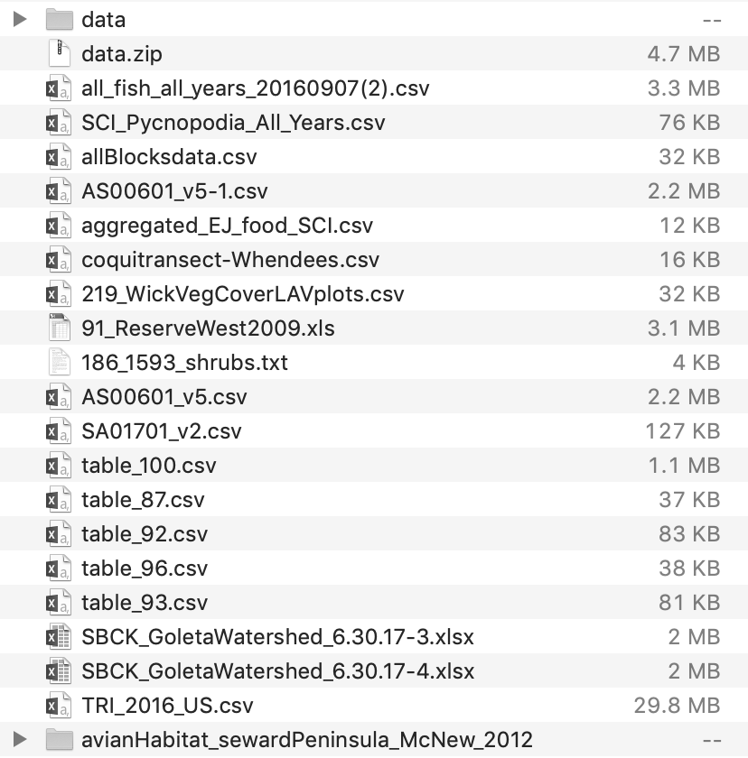
Wanted:
Openly available, curated datasets featuring learner-friendly, real-world environmental data that can help students consider environmental questions and learn data science / stats - that teachers can use out-of-the-box.
Notes:
Allison: What we thought would be really useful for a lot of environmental data science teachers would be an openly available collection of curated datasets featuring learner-friendly, real-world environmental data that can help students consider environmental questions and learn data science / stats skills. We already have some evidence that there would be demand for this...

Slide 7

palmerpenguins R package
By Allison Horst, Alison Hill, Kristen Gorman
Size data for penguins recorded by Dr. Kristen Gorman & others at Palmer Station Long Term Ecological Research site
> 140,000 downloads since July 2020
Widespread use in data science education materials
Notes:
Allison: Recently I, with my co-authors Dr. Alison Hill at RStudio and Dr. Kristen Gorman at the University of Alaska Fairbanks, developed and published the palmerpenguins R package, which contains a dataset called ‘penguins’ with size measurements (like flipper length, body mass, and bill dimensions) for 344 penguins observed by Kristen and her colleagues on islands in the Palmer Archipelago, Antarctica. Since being published on CRAN in July 2020, the palmerpenguins package has been downloaded over 140,000 times, was almost immediately recreated as Python and Julia packages, and is already widely used as an example dataset in teaching materials around the world. The message was clear: Teachers are craving awesome datasets. So we asked: if this one dataset is so useful for teachers, can we expand on it to provide a larger, more varied and more versatile collection of environmental datasets with educators in mind?

Slide 8
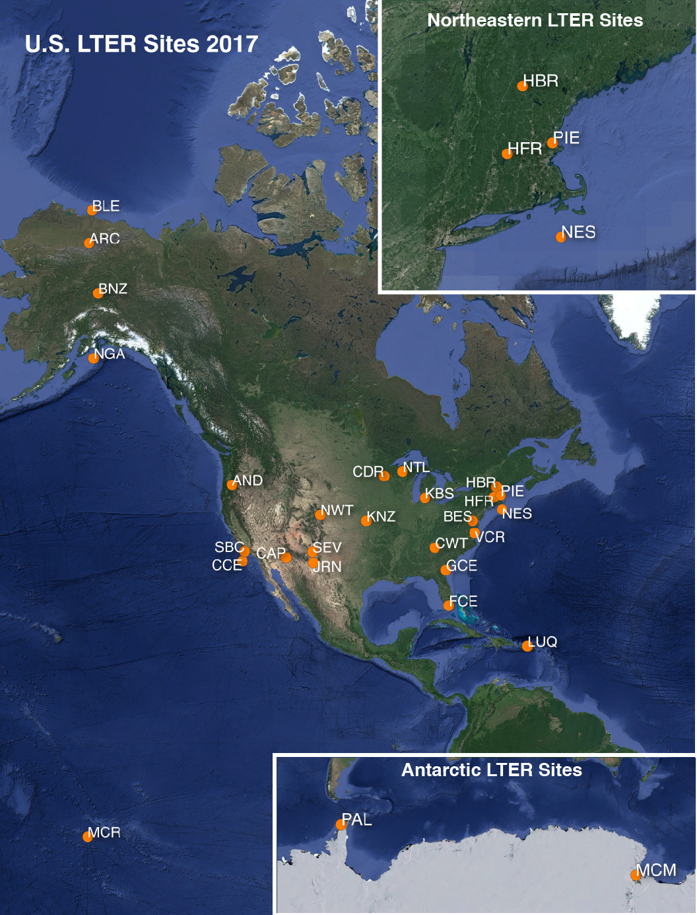
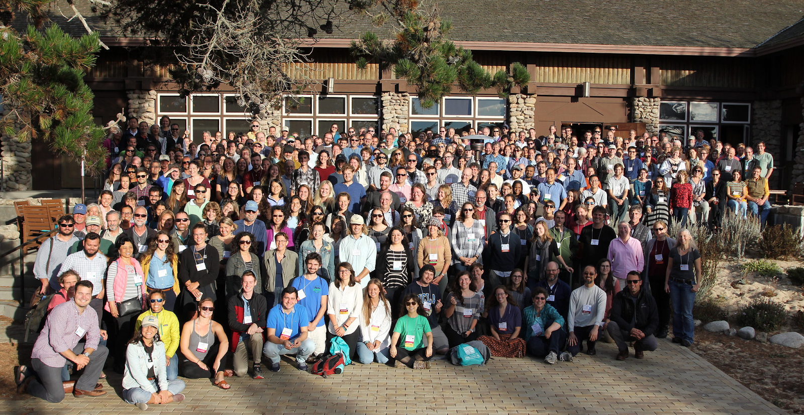
LTER all scientists meeting 2018
> 7,000 unique datasets since LTER founded in 1980
Notes:
Allison: Luckily, we already knew a good place to start looking for more datasets. The penguins data is from a single site - Palmer Station, Antarctica - that is part of a network of 28 sites that comprise the US Long Term Ecological Research Network, or LTER. The Long Term Ecological Research Network was founded in 1980, and over the past 40 years has collected and shared over 7,000 unique datasets covering vastly different ecosystems, spatial and temporal scales, and topics from marine biogeochemistry to urban heat islands to... penguin sizes!
In addition to collecting, studying and sharing both monitored and experimental data to understand long term ecological processes, the LTER Network’s mission also includes education, outreach, and a goal of “creating well-designed and well-documented databases.” … basically, the LTER is this amazing treasure trove of well-documented, openly available environmental datasets that we knew would be an ideal resource for this project.

Slide 9
We set out to make:
R package with one data sample from each LTER site
Input from LTER information managers & education team
Focus: teaching & learning data science
Complete documentation + access to raw data & metadata
Best practices for data management, documentation & sharing
Notes:
Allison: We set out to make:
An R package with one data sample from each LTER site
Input from LTER information managers & education team
Focus: teaching & learning data science
Complete documentation + access to raw data & metadata
Best practices for data management, documentation & sharing
Now I’ll pass it off to Julien to share how we did that.

Slide 10
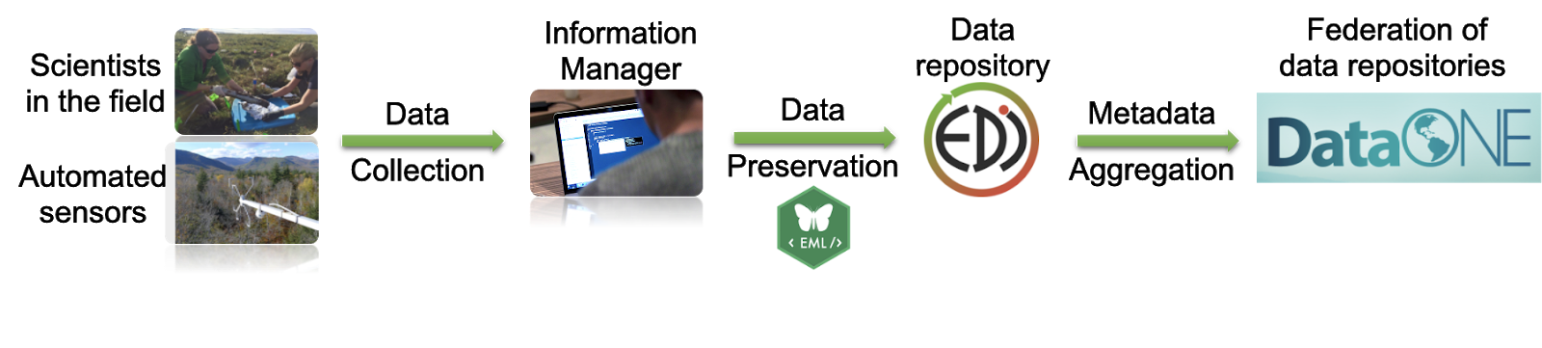
The life of an LTER dataset sample
Notes:
Julien: From the beginning we wanted to establish a reproducible workflow to ingest content into the lterdataset R package. We know that most of these data are long-term time-series and that in a few years we might want to update it. We also had the advantage that we could rely on the good practices and existing infrastructures used to manage LTER datasets.
The journey of a data sample from our package starts in the field where scientists collect data in sometimes difficult conditions.
Each LTER site has a data manager that is charge of documenting and preserving the data collected into a data repository, most of the time of LTER the environmental data initiative or EDI.
EDI is part of federation of data repositories DataONE which aggregates metadata from more than 40 data repositories to improve data discovery. DataONE provides APIs and R packages to interact with its services.

Slide 11
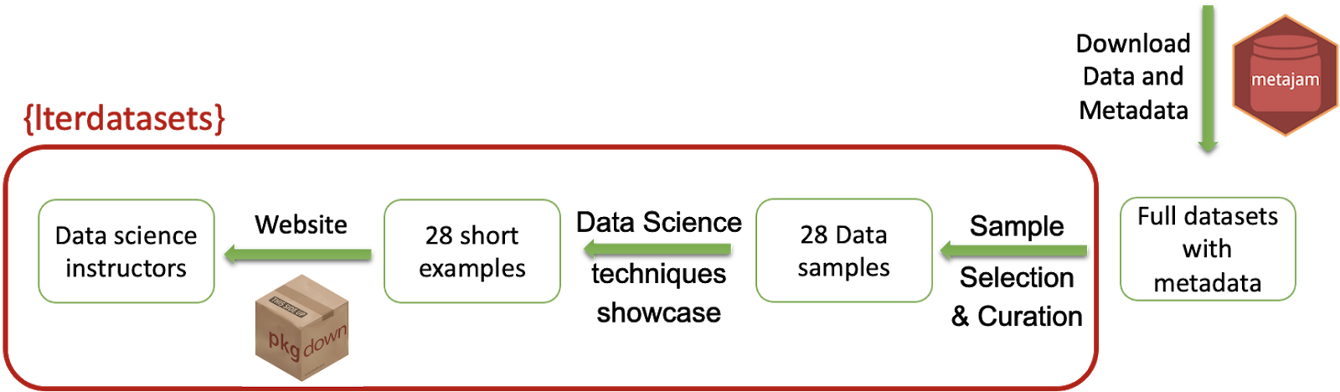
The life of an LTER dataset sample
Notes:
Julien: Once we had selected a dataset we thought of interest (a lot of trials and errors here as Allison mentioned earlier in the talk), we relied on the metajam package to download data and metadata directly into our R environment.
We then work on creating a sample from the original dataset to make it easy to both understand and manipulate. We leverage the original metadata to document the data sample in the R documentation.
Once we had our sample, we developed a vignette to showcase what type of data science manipulation could be taught using this specific datasets, such as for example how to deal with NAs, join two datasets, implement a regression and much more.
The final step was to create a website to make the package content more accessible and easier to navigate to non R users.

Slide 12
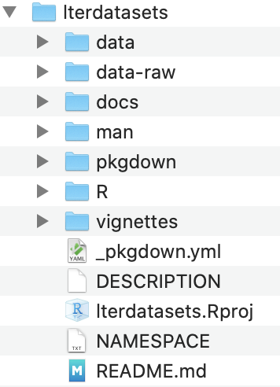
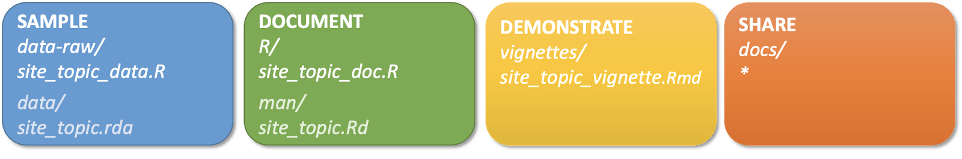
lterdatasets Structure
ntl_ice_data.R
ntl_ice_doc.R
ntl_ice_vignette.Rmd
Notes:
Julien: Diving a little deeper in our package structure, on the left you can see the file structure of the package with the usual suspect if you are used to R package.
We like to think of the content organized around 4 main categories:
1. Sample:
We developed R scripts to download the raw data and compute the sample. Although it is an R script we use R markdown tags to be able the happen these scripts at the bottom of the vignette showcasing potential Data Science topic to teach using this sample
Data samples were saved as a rda files in the data folder
2. Document: Then the documentation of the data sample was created relying on the original metadata. It was a very manual step we would love to automate at some point
3. Demonstrate: an Rmarkdown vignette was developed to showcase a specific type of analysis or data manipulation we think this dataset could be used to teach.
4. Share: Of course the R package is the main way we envision this content to be shared, but we also wanted to reach out non-R users and leverage packagedown and GitHub pages to expose the content via a website

Slide 13
UCSB Data Science capstone project
Product Develop data samples and accompanying examples
Goal Expose students to “real” data manipulations and R package development
Setup Team of 5 undergraduate students from Jan to June
Notes:
Julien: Once that workflow was established, we needed a team to help with dataset picking and developing use case examples. We wanted this to be a learning experience!
At the same time UCSB Data Science capstone program was seeking mentors to help their undergraduate students from the statistics and computer science departments to get first hand experience with real (ready messy) data.
We were able to onboard 5 talented students on our project to work with us from January to June to develop samples and examples.

Slide 14
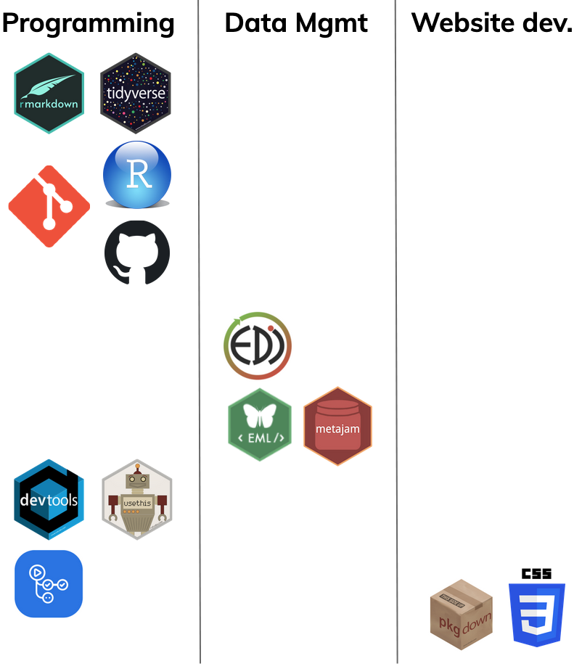
What did students need to learn?
Rmarkdown & tidyverse
git via RStudio
Collaborating with GitHub
Branches, PR & code review
Using data repositories
Search for data, leverage metadata
Use API to download content
Develop an R package
GitHub actions
Build a website
Notes:
Julien: We think a good way to group the skills students have developed through this project in 3 main categories:
Programming practices:
Data analysis doing a deep dive into the tidyverse and Rmarkdown
Collaborative coding practices learning how to work with others using git, GitHub and code review
R package development using devtool and usethis
Data Management: by finding data in data repository and learning how to leverage and create metadata
Website development: using tools from the Rmarkdown ecosystem such as package down but also customizing website using css.

Slide 15
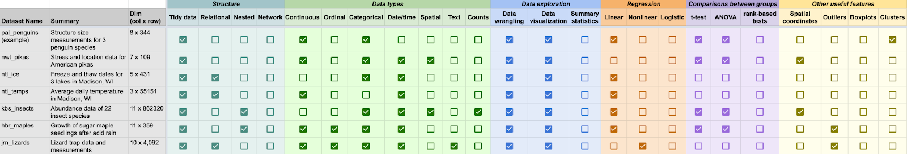
Currently
19 data samples created
Curating the vignettes to make the package coherent in terms of data science topics
Notes:
Julien: Currently the package contains 19 data samples created so far.
We are currently curating the vignettes to make the package more coherent in terms of data science topics. Here for example you can see that we do not currently have logistic regression covered.

Slide 16
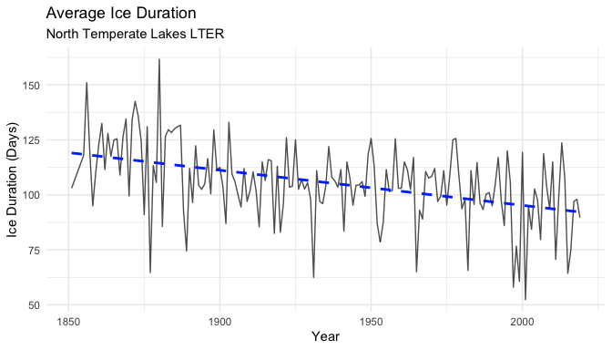
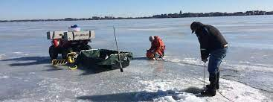
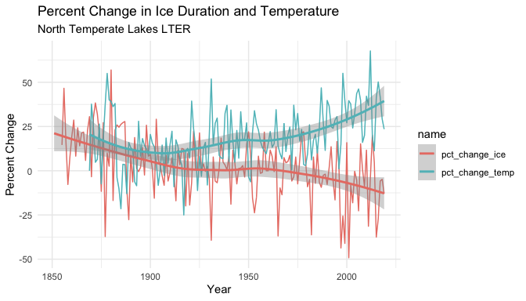
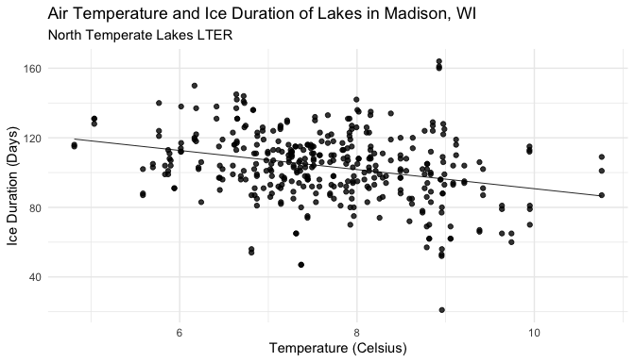
Dataset example: North Temperate Lakes - Ice Cover
Notes:
Julien: Here is an example of the content of a vignette about lake ice cover trends in the North Temperate Lakes. This example is looking how ice cover duration, a potential indicator of climate change, and air temperature are evolving over the last 150 years.
Developing this data sample and vignette required merging two different datasets of different temporal resolution and develop various data visualizations and analysis to investigate the trends and their relationship.
Now back to Allison for some final thoughts!

Slide 17
Closing thoughts:
Modern, curated, versatile and well-documented datasets are in demand and very appreciated
R packages are a user-friendly way to share datasets
A datasets package is a great project for data science students to combine many different skills and concepts
"At the start of Winter, I had no idea how to even begin developing an R package or collaborate with others using GitHub. I learned so much during my time on the project!" - Adhitya Logan (UCSB Undergraduate DS Capstone Member)
Notes:
Allison: While this is still a package in progress, some major takeaways from this project are: 1. First, modern, curated, versatile and well-documented datasets are in demand, and very appreciated by teachers and learners
2. When you do, you might consider sharing it as an R package, which is a great way to give other R users access to your data - including in environmental science, where R is one of the most common languages
3. And three, creating a datasets package in R is a great way for data science students and learners to combine *many* different skills and concepts in one meaningful project. One student on our team, Adhitya, recently sent along an email that said “At the start of winter, I had no idea how to even begin developing an R package or collaborate with others using GitHub. I learned so much during my time on the project!” So we definitely recommend making a datasets-based R package as a great learning project with what we think is a very valuable product!

Slide 18

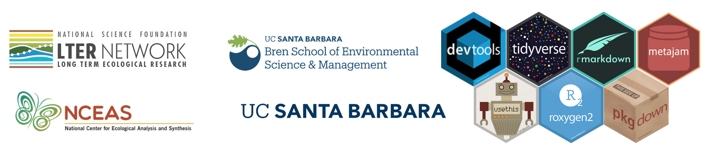
Thank you!
Students: Sam Guo, Adhitya Logan, Lia Ran, Sophia Sternberg, Karen Zhao
Course advisor: Dr. Sang-yun Oh
We’d love to hear from you!
Allison: ahorst@ucsb.edu ( : @allison_horst)
Julien: brun@nceas.ucsb.edu ( : @brunj7)
Our mini-test package (3 datasets): https://github.com/lter/lterdatasampler
Notes:
Allison: With that, we’d like to thank all the people and groups supporting this project. In particular we’d like to thank folks from the LTER Network including Marty Downs, site information managers and the education team for sharing ideas and feedback with us on this project. A huge thank you goes out to the 5 UCSB undergraduate students (Adithya, Karen, Lia, Sam and Sophia) for their hard work on this project, and to their capstone advisor Dr. Sang-Yun Oh. And also to the developers, maintainers, and contributors of R packages that made this project possible. We’ve shared a link here to a sampler version of our package containing three datasets, which is available to install from github at github.com/lter/lterdatasampler. We welcome you to try it out and would love to hear feedback from you. Thank you all for joining us, and enjoy the rest of the conference!

